Slide 1
Java
Security – авторизация (форма) + регистрация на сайте (с обменом данными с базой данных)

Slide 2
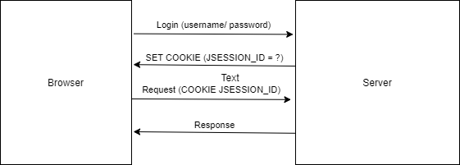
Session ID based security

Slide 3
Add Spring Security Dependency
<dependency>
<groupId>org.springframework.boot</groupId>
<artifactId>spring-boot-starter-security
</artifactId>
</dependency>

Slide 4
Password hashing
SHA1: https://passwordsgenerator.net/sha1-hash-generator/
sha1(„test“) = A94A8FE5CCB19BA61C4C0873D391E987982FBBD3
sha1(„Test“) = 640AB2BAE07BEDC4C163F679A746F7AB7FB5D1FA
Input: arbitary size
Output: fixed size „random“ value

Slide 5
Password salting
Salt is random data that is used as an additional input to hash function
String password= test
String passwordHash = sha1(„test“+“random nr“);

Slide 6
Bcrypt
bcrypt(„test“) = $2a$12$W/gc8koHTHAgZgCQAVOhyuLTqS7pCWIUvfczcfIM5yGtAtdCsFEqa
Bcrypt
Salt
Hash
How many rounds (adding 1 doubles the compute time)

Slide 7
User Detail Service
@Service public class UserDetailsServiceImpl implements UserDetailsService { @Autowired private PasswordEncoder passwordEncoder; @Override public UserDetails loadUserByUsername(String username) { return User.withUsername("test") .password(passwordEncoder.encode("test")) .roles("USER").build(); } }

Slide 8
Security Configuration
@Configuration @EnableWebSecurity public class SpringSecurityConfiguration extends WebSecurityConfigurerAdapter { @Override protected void configure(HttpSecurity http) throws Exception {…} @Bean public BCryptPasswordEncoder passwordEncoder() { return new BCryptPasswordEncoder(); } }

Slide 9
Security Configuration 2
@Override protected void configure(HttpSecurity http) throws Exception { http.authorizeRequests() .antMatchers("/", "/home").permitAll() .anyRequest().authenticated() .and() .formLogin() .permitAll() .and() .logout() .permitAll(); }

